Slide 1
Overview and theses – in light of the sustainability challenges (Thomas Dyllick)
When business problems are increasingly becoming dependent on societal problems, the «relevant practice» moves from the business-market to the business-society interface.

Slide 2
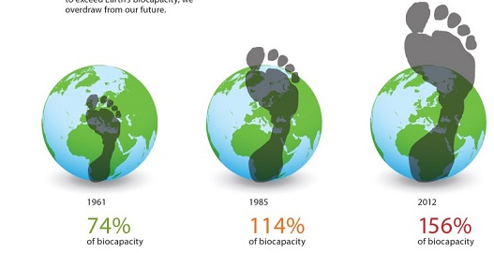
Humanity's Ecological Footprint
(Global Footprint Network/WWF)
Earth Overshoot Day 2017: August 2

Slide 3
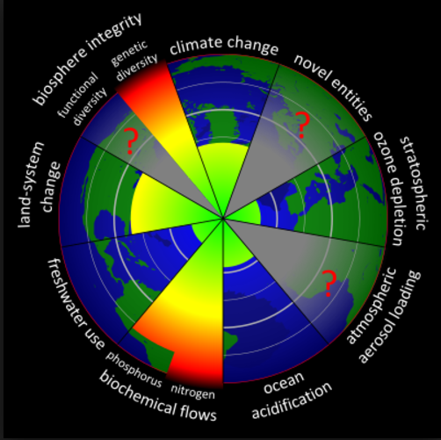
Planetary Boundaries
(Rockstrom, J. et al. 2009; Steffen, W. et al. 2015)
Gobal Risk Zone
Loss of biosphere integrity
Overload in Nitrogen and Phosphorous Cycles
Land-use change
Climate Change
Approaching limits
Global freshwater use
Ocean acidification
Undetermined limits
7. Atmospheric aerosols
8. Release of novel entities
Improving
9. Loss stratospheric ozone

Slide 4
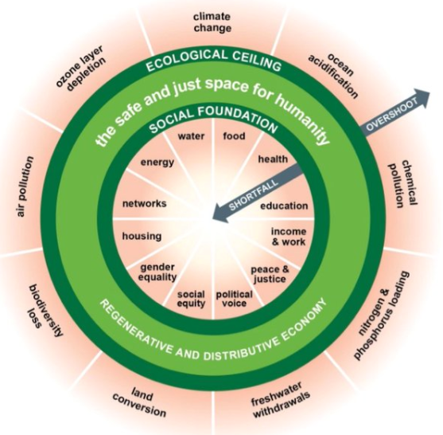
Doughnut Economics (Kate Raworth 2017)
From endless growth to thriving in balance («a safe and just space for humanity»)

Slide 5
Overview and theses – in light of the sustainability challenges (Thomas Dyllick)
When business problems are increasingly becoming dependent on societal problems, the «relevant practice» moves from the business-market to the business-society interface.
With the SDGs, businesses have gained a new “north star” for a world in constant change. They bring together world leaders, the business community, civil society and citizens around a shared vision for the world.

Slide 6
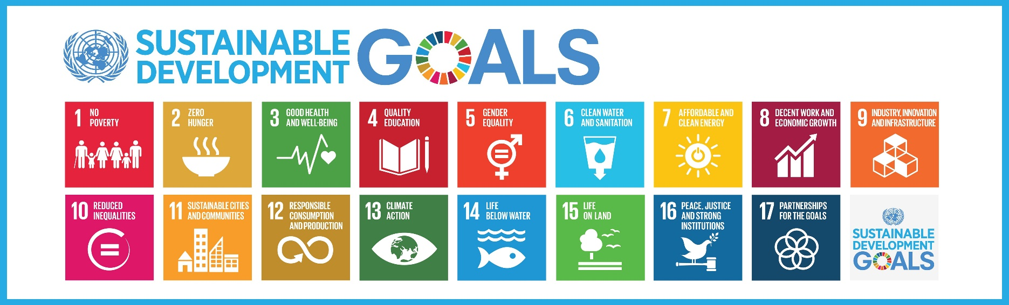
United Nations SDGs («Agenda 2030»)
«In 2050 around 9 million people living well and within the limits of the planet» (WBCSD: Vision 2050, 2010)
Global challenges create collective responsibilities
The SDGs create great expectations for business to act respon-sibly, but also huge new opportunities

Slide 7
Overview and theses – in light of the sustainability challenges (Thomas Dyllick)
When business problems are increasingly becoming dependent on societal problems, the «relevant practice» moves from the business-market to the business-society interface.
With the SDGs, businesses have gained a new “north star” for a world in constant change. They bring together world leaders, the business community, civil society and citizens around a shared vision for the world.
The challenge for business is to move from an “inside-out” to an “outside-in” perspective, thereby shifting its perspective from minimizing negative impacts to creating positive impacts in critical areas for society and the planet.

Slide 8
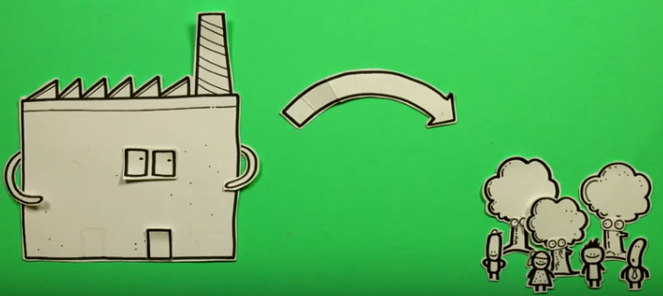
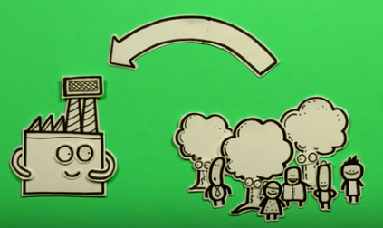
Outside-In: A Powerful new Perspective
Inside – Out
Outside - In
vs.
Risks & opportunities for current business
Reducing negative impacts (“the bads”)
New white-space opportunities
Making positive contri-butions (“the good”)

Slide 9
Overview and theses – in light of the sustainability challenges (Thomas Dyllick)
When business problems are increasingly becoming dependent on societal problems, the «relevant practice» moves from the business-market to the business-society interface.
With the SDGs, businesses have gained a new “north star” for a world in constant change. They bring together world leaders, the business community, civil society and citizens around a shared vision for the world.
The challenge for business is to move from an “inside-out” to an “outside-in” perspective, thereby shifting its perspective from minimizing negative impacts to creating positive impacts in critical areas for society and the planet.
Business School research needs to change fundamentally to remain relevant, credible and useful.

Slide 10
Challenges for Business School Research
from (scholarly) insight to (societal) impact
from explaining the past to helping shape the future
from narrow disciplinary questions to broad interdisciplinary challenges
from problems defined by the scholars themselves to a joint definition of problems that matter to practice and society
from an exaggerated focus on the production of research and scholarly output to relevant contributions and a broad dissemination of results
results feed into teaching and inform public discourse

Slide 11
Overview and theses – in light of the sustainability challenges (Thomas Dyllick)
When business problems are increasingly becoming dependent on societal problems, the «relevant practice» moves from the business-market to the business-society interface.
With the SDGs, businesses have gained a new “north star” for a world in constant change. They bring together world leaders, the business community, civil society and citizens around a shared vision for the world.
The challenge for business is to move from an “inside-out” to an “outside-in” perspective, thereby shifting its perspective from minimizing negative impacts to creating positive impacts in critical areas for society and the planet.
Business School research needs to change fundamentally to remain relevant, credible and useful.
Thanks a lot!

Slide 12
Thanks a lot!

