Slide 1

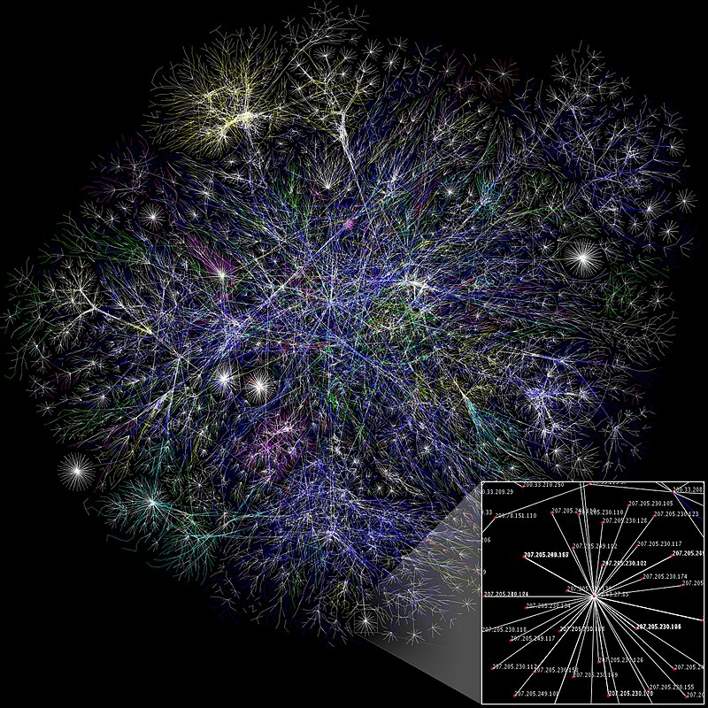

Pandemic Cyber Risk
Werner Schnell, Ph.D Candidate
(supervisor Prof. Martin Eling)
I.VW-HSG | St. Gallen, June 2019

Slide 2
Pandemic Cyber Risk
Introduction
Pandemic behavior poses a challenge for insuring cyber risk. Cyber threats spread quickly around the globe, are highly contagious, and can potentially affect a huge numbers of targets simultaneously. And the shock originated in cyber space might finally strike the real economy (WEF, 2016).
Modeling dependencies and risk aggregation for cyber risk is not yet sufficiently developed.
One approach is to use network models (Fahrenwaldt et al., 2017)*.
*Fahrenwaldt, M. A., Weber, S., & Weske, K. (2018). Pricing of cyber insurance contracts in a network model. ASTIN Bulletin: The Journal of the IAA, 48(3), 1175-1218.
Notes:
- Fahrenwaldt et al., 2017 use networks not in an underwriting context and do not consider real network structure.

Slide 3
Pandemic Cyber Risk
Methodology
Bottom up:
Networks
Top down: Correlation, Copula
The network model can include non-homogeneity such as hubs, small world property, and different infection and recovery rates (IT security).
opte.org (2005)
Notes:
Starke Klusterbildung (Hubs), d.h. neue Links bevorzugen Knoten die bereits viele links haben.
Small world property

Slide 4
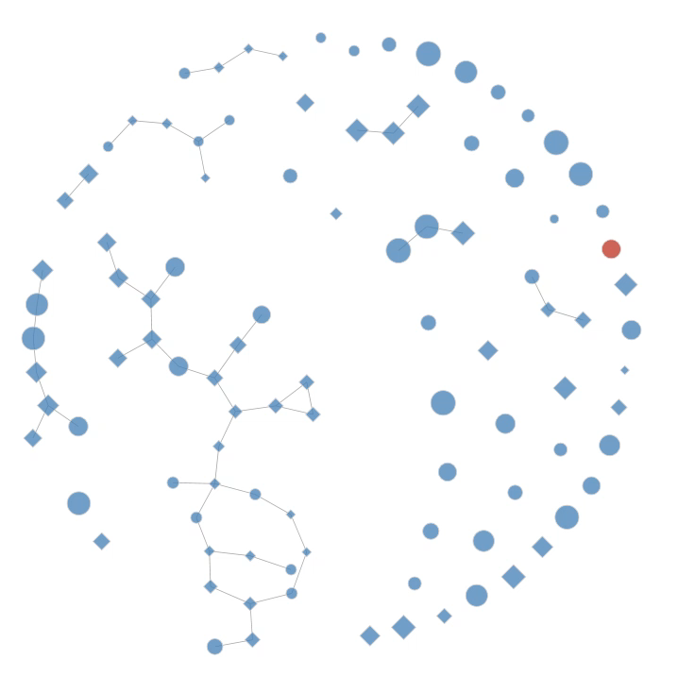
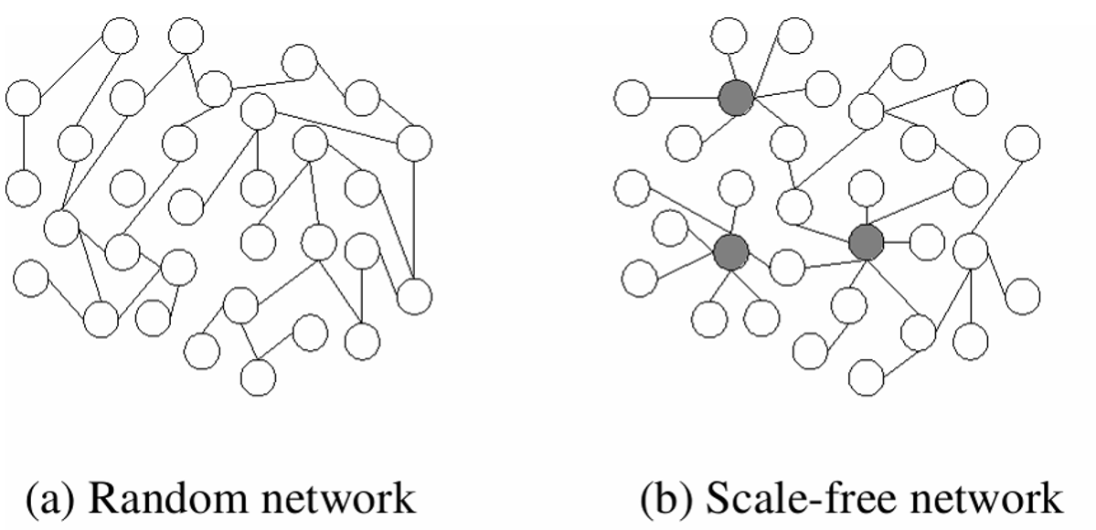
Pandemic Cyber Risk
Methodology
Networks
How is the network formed and how are the nodes connected (hubs)?
How does the network structure change over time?
Pandemic
What is the probability that two neighbor nodes infect each other (IT security)?
Can an infected node be recovered and if yes how fast?
Notes:
Ein Knoten ist bei Beginn infiziert.
Damit sich eine Infektion ausbreiten kann, ist ein Kontakt notwendig
Netzwerkmodelle ermöglichen das Modellieren von nicht homogenen Charakteristiken (e.g. IT-Sicherheit) und bietet Einblicke in die zugrundeliegenden kausalen Zusammenhänge.
Scale free (Barabasi and Albert, 1999)
The hubs (also called super spreaders) in an underwriting portfolio could be critical IT companies such as cloud services (e.g. Dropbox), social media (e.g. Facebook), or IT companies at provide other critical services (e.g. Microsoft, Android, Cisco, air traffic systems.

Slide 5
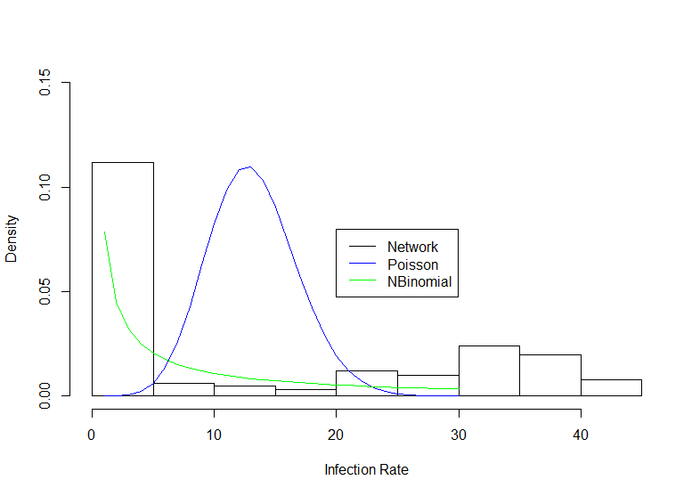
Pandemic Cyber Risk
Outcome
We obtain a frequency distribution that can be used to model the aggregated distribution at the insurer’s portfolio level.
Hubs and small world property lead to extreme (heavy) tailed frequency distribution and ….

Slide 6
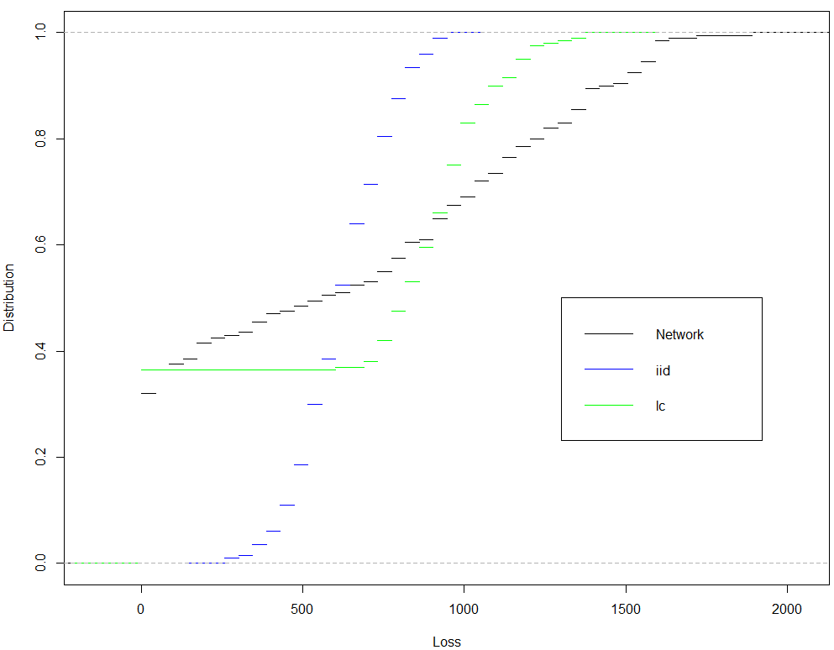
Pandemic Cyber Risk
Outcome
… thus to more heavy tailed aggregated distributions.
Portfolio Distribution
The plot shows the cumulative loss distribution function of an insurer’s portfolio of 50 cyber policies simulated from the network model and compares it to linear correlation (lc) and independent frequencies (iid).

Slide 7
Pandemic Cyber Risk
Conclusions
Network models help insurers to model cyber risks more realistically and can improve regulatory and actuarial models.
Network models can be used to derive more concrete suggestions for insurers and regulators:
Insurers should look out for hubs in their underwriting portfolio (e.g. high-tech and software companies, cloud services, social media).
Clients with strong interconnections should be required to have better IT security, charged higher premiums and capital.
However, networks models have more degree of freedom and use more detailed information about the underlying contagion process. As a consequence more modeling and parameter risk emergence.
Notes:
- Regulation of critical hubs otherwise?

Slide 8
Pandemic Cyber Risk
Questions
Is a concentration on malware (spreading through the internet) broad enough?
How can the parameters be empirically calibrated?
Do we need for this kind of models too many assumptions (e.g. infection rate, network structure)?
Possible extension would be to combine the underwriting portfolios for several insurers to analyze the accumulation risk (e.g. at the reinsurer level).
Notes:
- Worst case: what if the biggest hubs would get infected.

Slide 9
Thanks!

