Slide 1
PiF Seminar HS 2018
EXTREME CYBER RISKS AND THE NON-DIVERSIFICATION TRAP
Werner Schnell*, Ph.D Candidate
(with Prof. Martin Eling*)
*Institute of Insurance Economics, University of St.Gallen
Notes:
September 25, 11:15; 01-103 (main building 01)
Welcome to my presentation (thanks)
Third paper in a row on cyber risk (lith. review, regulatory)
4. Paper about systemic risk

Slide 2
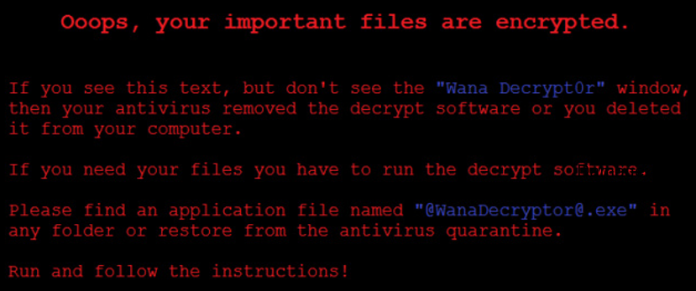

Cyber Risk Market
Status Quo
Estimated global costs per year: $445 billion (McAfee 2010)
Cyber insurance market is lagging behind expectations:
Only 6% of U.S. companies have cyber insurance (Willis 2013).
In Europe only 1% of individuals possess cyber insurance (YouGov 2014).
Europe’s cyber insurance market is even less developed then the U.S. market.
Damage: up to $1 billion
Just a question of time or is something fundamentally wrong with cyber risk?
Notes:
Sony vs Zurich Insurance:
have reached a settlement in a commercial general liability (CGL) policy coverage case stemming from the April 2011 hacking of Sony’s PlayStation online services.
The data breach had exposed personal information of tens of millions of users.
Silent cover in liability insurance
Awareness for cyber risk not existent

Slide 3
Contribution
Extending understanding of cyber risk
Suggesting models for policy, regulation, risk management, reserving and pricing
How do these characteristics lead to market failure?
How could market failure be addressed?
Development of cyber insurance market and efficiency gains!
Notes:
- Major problem: not explicit treatment of cyber risk in any framework

Slide 4
Characteristics of Cyber Risk
Reasons for underdeveloped cyber insurance market (see, e.g., Biener et al. 2015)
Lack of data and established models
Fast changing environment: Is the data we have so far representative for the future?
Modeling and parameter uncertainty
Only way out: modeling based on scenarios?
Asymmetric information costs (screening, monitoring)
Heavy tails and strong (tail) dependency
Notes:
Cyber Risk might be a new type of risk:
Still trying to grasp cyber risk
Not enough data; high uncertainty
Fitch Ratings (2016) warned to downgrade insurers that write standalone products to heavily
Risk is very fast changing and still an emerging risk
Results so far: highly correlated (no geographical boundaries) and probably heavy tail (extreme events so far not realized, skewness).
Probably tail correlation (non linear correlation)
Only alternative would be scenarios (Cambridge Centre for Risk Studies)

Slide 5

Model Framework
Insurer’s decision whether to underwrite cyber risk based on expected utility framework (extending Ibragimov & Ibragimov et al. 2009):
Modeling uncertainty
Risk aversion
EU
$E^{ℙ}\left(U\left(f(Z,π;n) \right)\right)$, $ℙϵ𝒫$
Aggregation
Premium
Risk distribution
n
Notes:
Our analysis contributes in all these fields:
P captures the modelling risk. It describes all possible distribution assumption (contains statistical modelling risk)
U describes the risk aversion. It can also be the prospect theory utility
f() stands for the aggregation of individual risk to portfolio
Premium: asymmetric information costs (different under competition and monopoly)
Only distribution and correlation investigated so far
The way the cyber peculiarities are considers determines the portfolio value.
- Ibragimov, R. (2009). Portfolio diversification and value at risk under thick-tailedness. Quantitative Finance, 9(5), 565-580.
- Ibragimov, R., D. Jaffee, and J. Walden. 2009. Nondiversification Traps in Catastrophe Insurance Markets. Review of Financial Studies 22 (3)

Slide 6

Cyber Risk Data
Baseline
Robustness check
Cyber incidents extracted from the SAS Operational Risk database (credits to Jan Wirfs)
Privacy Rights Clearinghouse (PRC) data breaches (since 2005)
Notes:
Cyber risk exposure is modeled based on publicly available data:
SAS
1,579 cyber risk losses SAS
1995-2014
Global publicly reported cyber incidents
PRC
Records brechend:10 Billion
Reported in the US
Problem of reporting bias (for SAS only above 100’ USD).
-SAS Data from Biener et al. (2015)
-Is the data representative for underwriting cyber risk exposure?

Slide 7
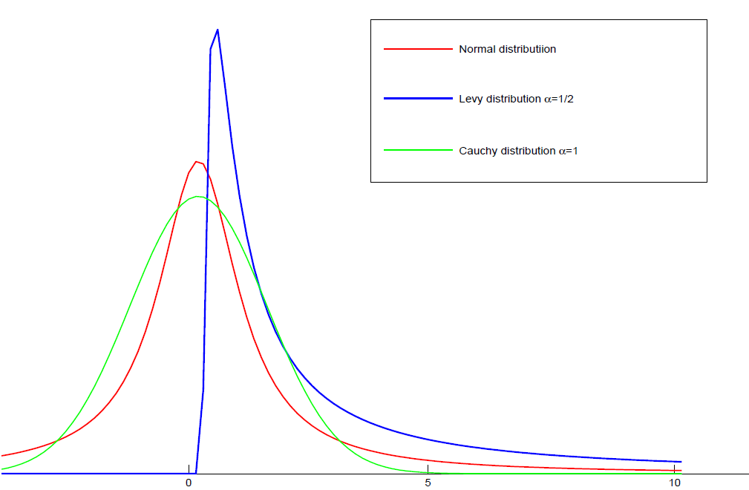
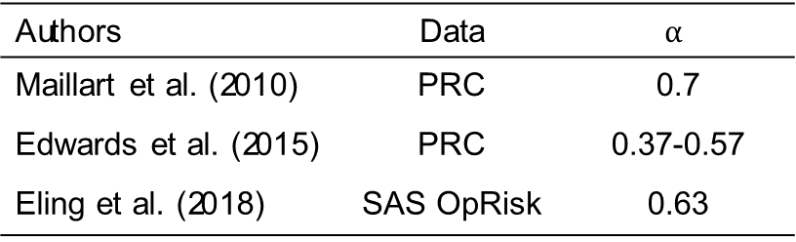
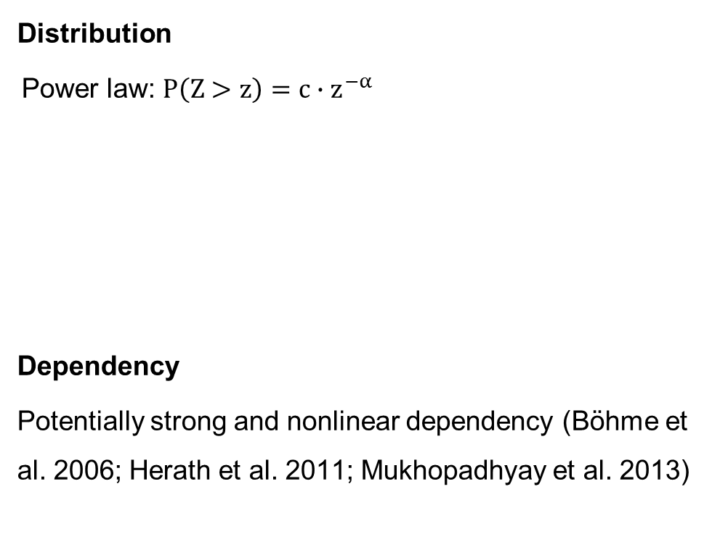
Characteristics of Cyber Risk
Distribution
Power law: $P\left(Z>z\right)=c∙z^{−α}$
Dependency
Potentially strong and nonlinear dependency (Böhme et al. 2006; Herath et al. 2011; Mukhopadhyay et al. 2013)
Authors | Data | $$α$$
Maillart et al. (2010) | PRC | 0.7
Edwards et al. (2015) | PRC | 0.37-0.57
Eling et al. (2018) | SAS OpRisk | 0.63
Notes:
$α:$ Pareto (or Tail) index
(extremely) heavy tailed if$(α<1) α<2$
-$I$nfinite second (first) and higher moments do not exist if $α<2 (a<1)$
If α > =2 diversification is optimal over non diversification (Ibragimov)
Find that the estimated α<1
Similar tail index for cat / terror / operational risk
- Operational risks: α < 1; Firm sizes, sizes of largest mutual funds, city sizes: α ≈ 1; Economic losses from earthquakes: α ∈ [0.6, 1.5]
Böhme et al: better data would be required in order to estimate suitable copulas and parameters empirically.

Slide 8

Model Framework
Risk aversion
Modeling uncertainty
$E^{ℙ}\left(U\left(f(Z,π;n) \right)\right)$, $ℙϵ𝒫$
Aggregation
Premium
Risk distribution
Notes:
Premium due to modelling uncertainty?
Prohibitive: Non participation of clients

Slide 9
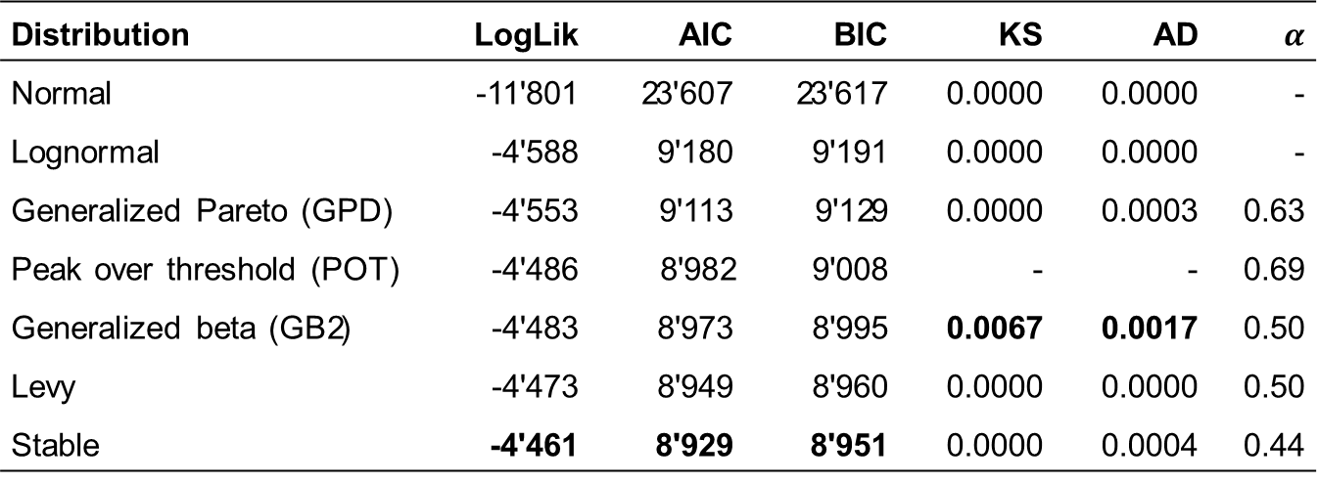
Characteristics of Cyber Risk
Modeling uncertainty (1)
Distribution | LogLik | AIC | BIC | KS | AD | $$α$$
Normal | -11'801 | 23'607 | 23'617 | 0.0000 | 0.0000 | -
Lognormal | -4'588 | 9'180 | 9'191 | 0.0000 | 0.0000 | -
Generalized Pareto (GPD) | -4'553 | 9'113 | 9'129 | 0.0000 | 0.0003 | 0.63
Peak over threshold (POT) | -4'486 | 8'982 | 9'008 | - | - | 0.69
Generalized beta (GB2) | -4'483 | 8'973 | 8'995 | 0.0067 | 0.0017 | 0.50
Levy | -4'473 | 8'949 | 8'960 | 0.0000 | 0.0000 | 0.50
Stable | -4'461 | 8'929 | 8'951 | 0.0000 | 0.0004 | 0.44
Notes:
- Frequently used lognormal not appropriate (regulators, risk management)
LogLik stands for the logarithmic likelihood of the maximum likelihood (ML) estimation, AIC for the Akaike information criterion, BIC for Bayesian information criterion, KS for the Kolmogorow-Smirnow test, and AD for the Anderson-Darling test.
Eling & Wirfs (2016) suggest a lognormally distributed body and a Pareto distributed tail
POT approach slices a lognormal body and a Pareto distribution from the 80% quantile upwards.

Slide 10
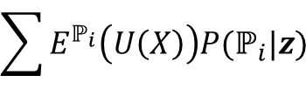


Characteristics of Cyber Risk
Modeling uncertainty (2)
Model choice (see, e.g., Cont 2006):
Selecting models based on the likelihood / information criterion
(Bayesian) model averaging:
Select worst case:
So far we merely rely on nested models.
What about estimating premium for model uncertainty?
$$\sum{E^{ℙ_{i}}\left(U\left(X\right)\right)P(ℙ_{i}|z)}{}$$
$$\min_{ℙϵ𝒫 }{E^{ℙ}\left(U\left(X\right)\right)}{}$$
$ε=E^{ℙ}\left(U\left(X\right)\right)−E^{\dot{ℙ}}\left(U\left(X\right)\right)$, $ℙϵ𝒫$

Slide 11
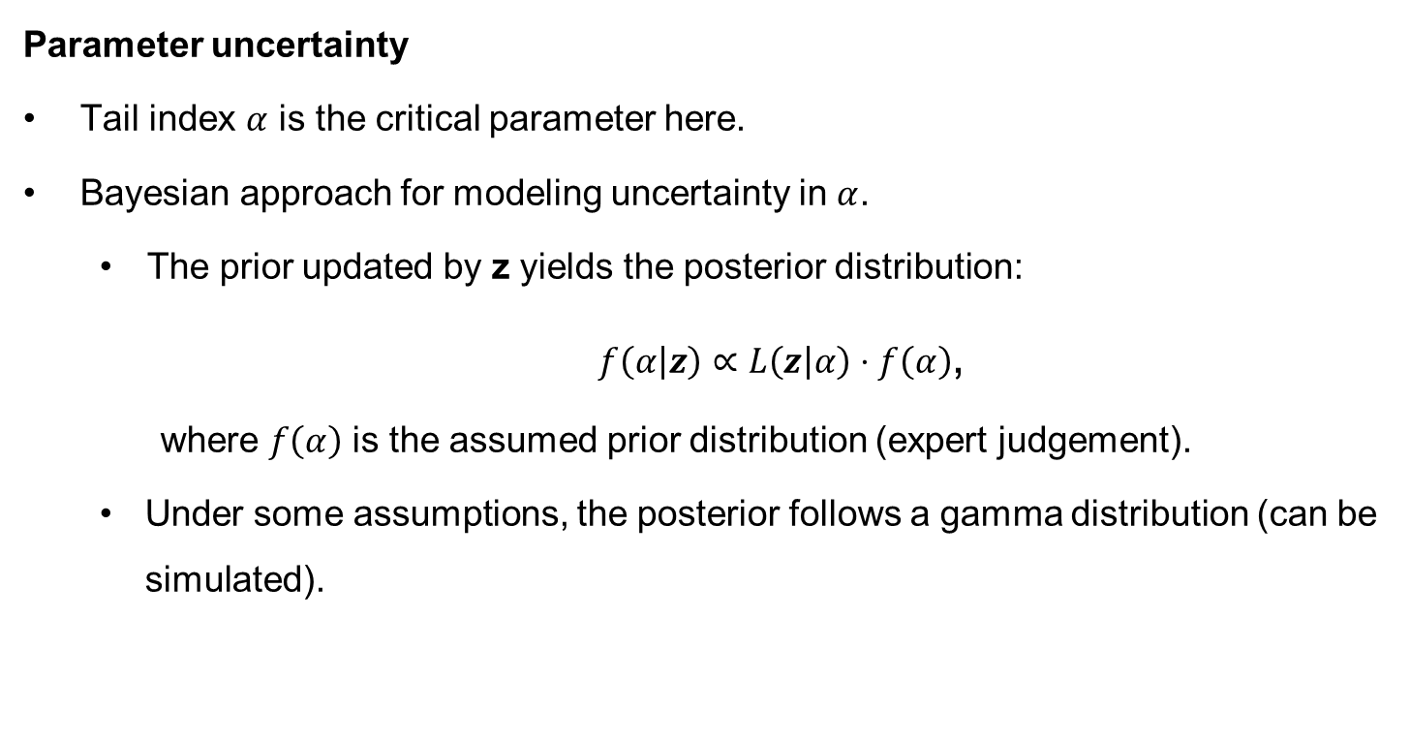
Characteristics of Cyber Risk
Parameter uncertainty
Tail index $α$ is the critical parameter here.
Bayesian approach for modeling uncertainty in $α$.
The prior updated by z yields the posterior distribution:
$f\left(α | z\right)∝L\left(z | α\right)⋅f\left(α\right)$,
where $f\left(α\right)$ is the assumed prior distribution (expert judgement).
Under some assumptions, the posterior follows a gamma distribution (can be simulated).
Notes:
- The assumtion are Pareto density (loglik) and (1/a) prior

Slide 12

Model Framework
Modeling uncertainty
Risk aversion
$E^{ℙ}\left(U\left(f(Z,π;n) \right)\right)$, $ℙϵ𝒫$
Aggregation
Premium
Risk distribution

Slide 13

Methodology
Portfolio formation in 6 steps
1) Cover limits
$$\hat{Z}=\left\{\begin{aligned}cl, if Z<cl \\ Z, if Z≥cl\end{aligned}\right.$$
2) Loss distribution approach (frequency & severity)
$${\tilde{Z}}_{i}=π^{∗}+I∙{\hat{Z}}_{i}$$
Notes:
$I$ is Bernoulli distributed meaning it is one with a probability $q$ and 0 with a probability $(1−q)$.

Slide 14
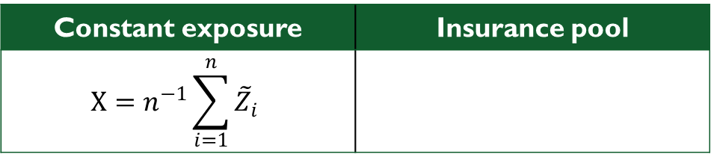

Methodology
Portfolio formation (2)
3) Portfolio aggregation
Constant exposure | Insurance pool
$$X=n^{−1}\sum_{i=1}^{n}{{\tilde{Z}}_{i}}$$
$$X=s^{−1}\sum_{i=1}^{N}{{\tilde{Z}}_{i}}$$
Notes:
IID case:
Keeping portfolio size constant (Sum of n RVs divided by n)
Deterministic sum here
We assume strong negative tail dependency
Maybe due to significant spill-overs in times of extreme events
-> Clayton copula

Slide 15

Methodology
Portfolio formation (3)
4) Limited liability ($ll$)
$$\hat{X}=\left\{\begin{aligned}ll, if X<ll \\ X, if X≥ll\end{aligned}\right.$$
5) X is either simulated or its distribution $F_{X}(x)$ is derived numerically (Panjer recursion).
6) Finally portfolio value is evaluated.
Notes:
We need to assume how the model (of not clear) needs to be applied -> we can not ask the regulator for a ruling
- Frequency: for a portfolio of 50 (0.15*50), here Poisson model
- Severity: Caped at 50 Mio. USD, empirical distribution (defined on a lattice, h=0.1 Mio. USD)
Panjer recursion is only applicable to a certain class of frequency distribution
$F_{X}(x)$=${F_{Z}(Z_{i}) }^{∗n}$ numerically not solvable.
Simulated VaR as used by SII

Slide 16
Model Framework
Modeling uncertainty
Risk aversion
$E^{ℙ}\left(U\left(f(Z,π;n) \right)\right)$, $ℙϵ𝒫$
Aggregation
Premium
Risk distribution

Slide 17
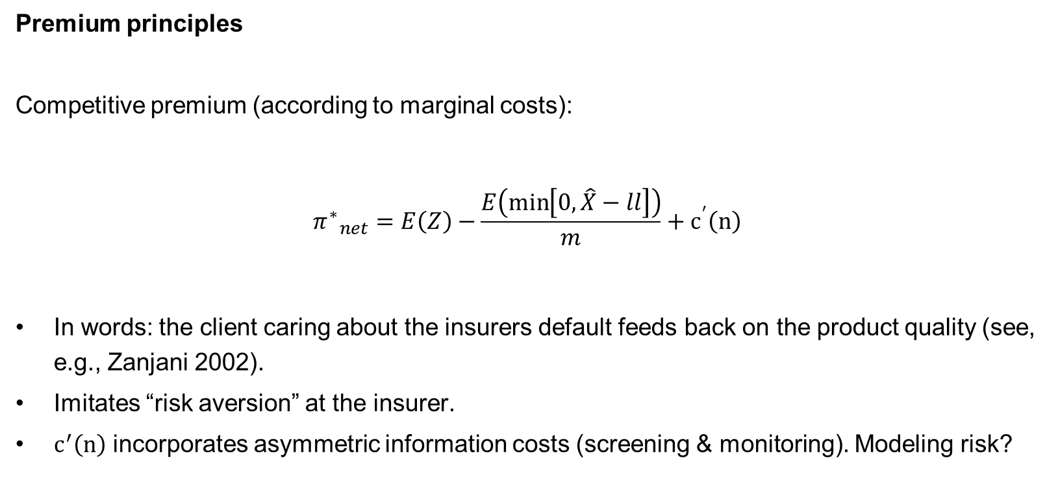
Methodology
Premium principles
Competitive premium (according to marginal costs):
$${π^{∗}}_{net}=E\left(Z\right)−\frac{E\left(\min\left[0,\hat{X}−ll\right]\right)}{m}+c^{′}\left(n\right)$$
In words: the client caring about the insurers default feeds back on the product quality (see, e.g., Zanjani 2002).
Imitates “risk aversion” at the insurer.
$c^{′}\left(n\right)$ incorporates asymmetric information costs (screening & monitoring). Modeling risk?
Notes:
Where m is the number of cyber policies per insurer
We also use monopolistic pricing.

Slide 18
Model Framework
Modeling uncertainty
Risk aversion
$E^{ℙ}\left(U\left(f(Z,π;n) \right)\right)$, $ℙϵ𝒫$
Aggregation
Premium
Risk distribution

Slide 19
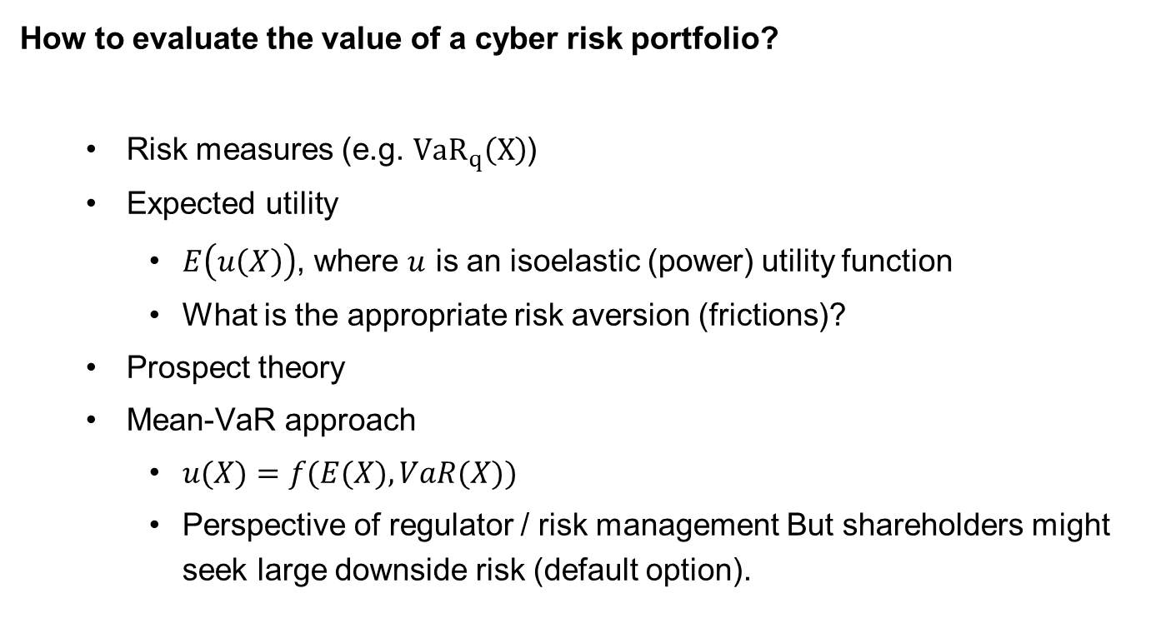
Methodology
How to evaluate the value of a cyber risk portfolio?
Risk measures (e.g. ${VaR}_{q}\left(X\right)$)
Expected utility
$E\left(u\left(X\right)\right)$, where $u$ is an isoelastic (power) utility function
What is the appropriate risk aversion (frictions)?
Prospect theory
Mean-VaR approach
$u(X)=f(E(X), VaR(X))$
Perspective of regulator / risk management But shareholders might seek large downside risk (default option).
Notes:
$q: prob einen verlust nicht zu überschreiten$
Expected utility neglects loss aversion and probability weighting
PT should mitigate this problem
Mean-VaR: anyone who is sensitive to extreme losses)

Slide 20

Model Framework
$E^{ℙ}\left(U\left(\left(f(Z,π;n) \right)\right)\right)$, $ℙϵ𝒫$

Slide 21
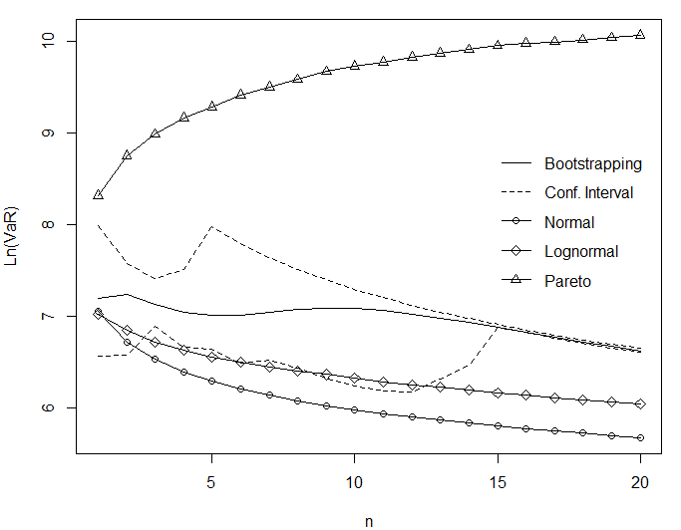
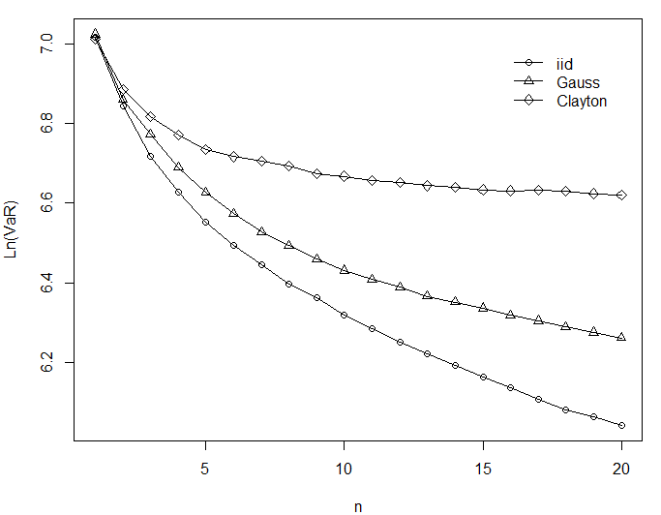

Results
Constant exposure (one insurer)
$α<1$
Independent
Dependent
Notes:
Normal (α=2) & lognorm lead to decreasing VaR ->Merits of diversification
Pareto: Risk increases as portfolio size does
Perfect dependency (comonotonicity): no diversification effect -> ${VaR}_{q}$ constant (independent of tail index)
E.g. Archimedean copula the same as iid for sufficient small loss probability $q$.

Slide 22
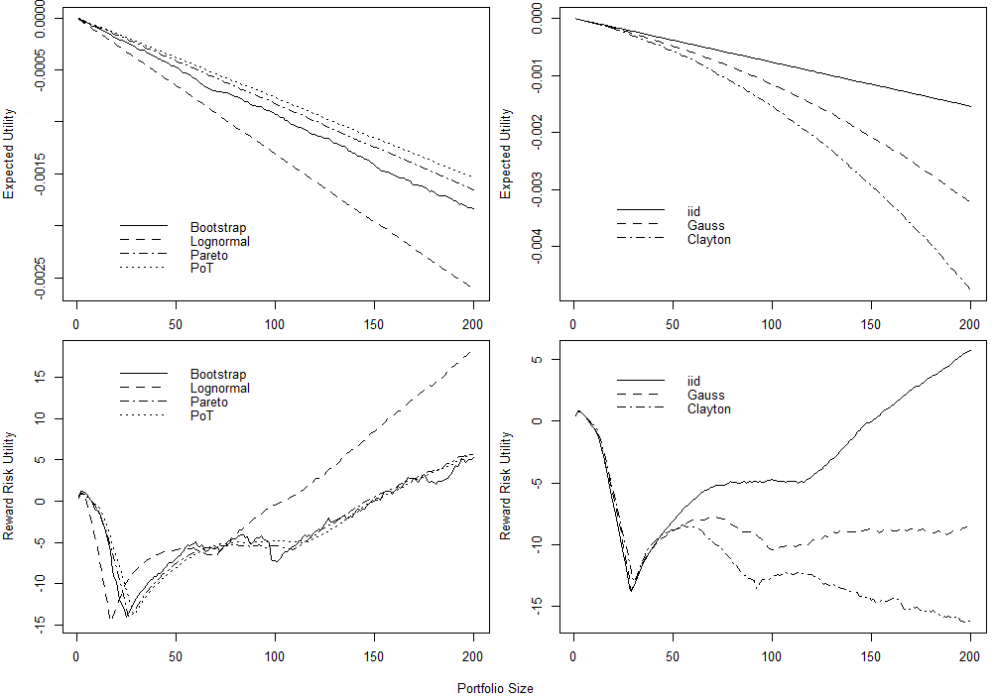
Results
One insurer

Slide 23
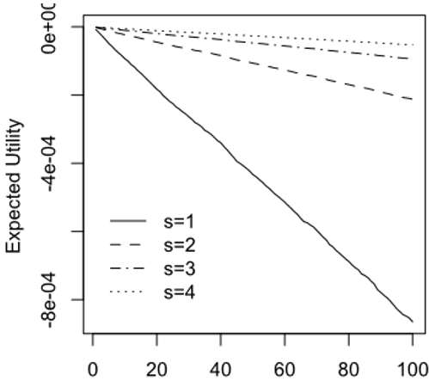
Results
Insurance pool
Notes:
-Similar for other valuation models & ambiguity (uncertainty) aversion.
- The deadweight costs of bankruptcy, including a loss in the value of
the managers’ human capital, could then motivate the unwillingness of firms to
participate in the catastrophe insurance.
- have largely failed.
In this paper, we argue that the observed dynamic pattern of widely varying
supply conditions for catastrophe insurance and reinsurance could reflect
a multiple equilibrium system, with the market sometimes reaching a coordinated
reinsurance/diversification equilibrium, but at other times falling into
what we call a nondiversification trap.

Slide 24
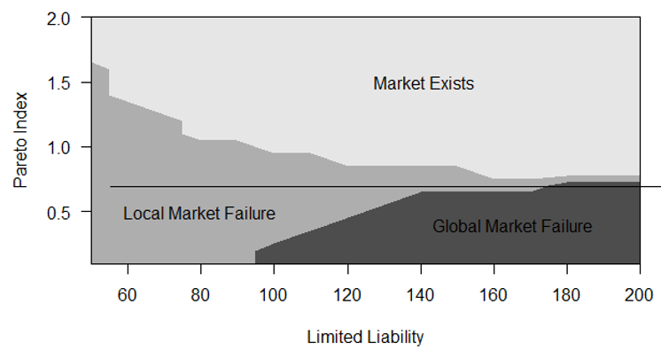
Results
Robustness:
Market outcome dependent on parameters

Slide 25
Conclusion
Findings
Genuine diversification trap (decreasing portfolio value)
Market stays underdeveloped unless subsidized.
Local diversification trap
(U-shaped portfolio value)
However, a subsidized market might not be desirable from a welfare perspective.
Utility negative for individuals but positive for society
Public coordination desirable
Very heavy tails and strong (tail) dependencies cause diversification to fail.
Very heavy tails combined with cover limits / limited liability
Market stays underdeveloped if coordination problem is not solved.
Notes:
-As there seems to be a game theoretical coordination problem

Slide 26
Conclusion
Recommendations
To overcome the diversification trap, the government could
incentivize risk pools & encourage the use of reinsurance (e.g. TRIA)
make insurance supply or demand compulsory (e.g. TRIA)
provide public insurance (e.g. NFIP)
Data quality and models should be improved:
Data pools
Reporting requirements
Increasing awareness and educating clients, employees and public about cyber risk.
Notes:
- National Flood Insurance Program (NFIP)
Terrorism Risk Insurance Act (TRIA)
The availability of better data in the future would open up new research opportunity.
Unable to accurately model or price terrorism exposures, reinsurers largely withdrew from the market for terrorism coverage. Without reinsurance, primary insurers were then compelled to exclude terrorism. Most state insurance regulators approved terrorism exclusions for use by primary insurers.
Congress responded by enacting TRIA in November 2002 to provide a government reinsurance backstop in case of large-scale terrorist attacks, requiring that business insurers offer terrorism coverage for the types of insurance included in the act

Slide 27
Conclusion
Recommendations
Regulatory models
should consider heavy tails and tail dependency (introducing dedicated risk categories)
must account for that the risk does not decrease as the underwriting portfolio gets larger (no capital reduction for diversification)
However, this would hinder the development of a cyber insurance market.
Notes:
-E.g. SII is based on the lognormal; this seems not to be appropriate if the risk is heavy tailed.
-Major problem: not explicit treatment of cyber risk in any framework
Need to be modelled differently:
- Operational Cyber Risk: Insurers digitalized their operations and are therefore prone to cyber risk
- Underwriting Cyber Risk: Stand alone (dedicated) cyber risk policies or it is included in liability & property insurance. Sometimes not clear whether cyber risk is included (see Sony vs. Zürich, 2011).
Importantly: Probably a correlation between op and underwriting cyber risk
Capital charges assume some diversification.
Therefore regulatory frameworks might not be appropriate.

Slide 28
Questions and Discussion
Thanks a lot for your attention!

Slide 29
Conclusion
Implications
Generally, we can’t rely on classical mean variance analysis and results.
Raison d’être of insurers questionable if they can not diversify.
Non-diversification leaves idiosyncratic risk price relevant and the premium charged by insurers even increases as more risks are pooled.
Multi-equilibrium could emerge:
Dynamically (times where reinsurance is available and when it is not)
Segmentation of cyber market (separating different types of cyber risk)
Notes:
A major part of cyber threats distributes over the internet and therefore the correlation might be higher than for other underwriting risk. Moreover, extreme scenarios suggest that cyber risk could accumulate and become catastrophic
However, while insurers can geographically diversify cat risk, cyber risk propagated by the Internet does not know any boundary.
The limitation of this paper lays with the quality of available data and whether the data represents cyber risk in general well.
Diversification does not reduce VaR as expected: The regulator thus must account for that.
For example, since the risk does not decrease with diversification there should be no capital discount for diversification.
insurance). The traditional framework uses concave
optimization (e.g., via expected utility), with thin-tailed risks (e.g. normal
distributions), and without distortions (unlimited liability, no frictions and no
fixed costs). If any of these assumptions fails, diversification may not always be
preferred.5

Slide 30
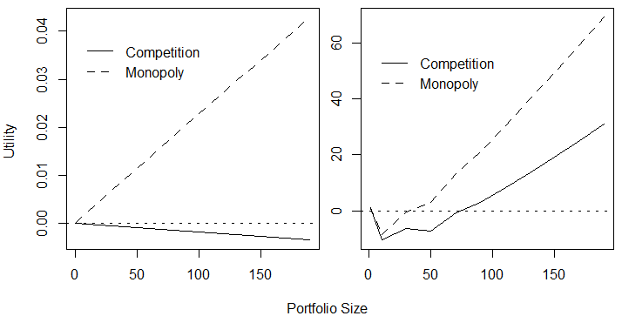
Competition vs Monopoly

