Slide 1
44th EGRIE Seminar
EXTREME CYBER RISKS AND THE NON-DIVERSIFICATION TRAP
Werner Schnell*, Ph.D Candidate
(with Prof. Martin Eling*)
*Institute of Insurance Economics, University of St.Gallen
Notes:
Cyber Risk might be a new type of risk:
Still trying to grasp cyber risk
Not enough data; high uncertainty (Fitch Ratings (2016) warned to downgrade insurers that write standalone products to heavily)
Risk is very fast changing and still an emerging risk (WannaCry ransomware )
Results so far: highly correlated (no geographical boundaries) and probably heavy tail (extreme events so far not realized, skewness).
Probably tail correlation (non linear correlation)
Only alternative would be scenarios (Cambridge Centre for Risk Studies)
Therefore regulatory frameworks might not be appropriate.

Slide 2
Cyber Risk Market
Status Quo
Cyber risk market is lagging behind expectations:
  Only 6% of U.S. companies have cyber insurance (Willis, 2013b).
  In Europe only 1% of individuals possess cyber insurance (YouGov, 2014).
Europe’s cyber market is even less developed then the U.S. market.
Silent cover in liability insurance (e.g. Zürich vs Sony Corp)
Just a question of time or is something fundamentally wrong with cyber risk?
Notes:
Diversification: Problem c
U.S. show a similarly low average level of coverage of about 6 per cent, but large variations between industries among the Fortune 1000 companies (Willis, 2013b)
apital charges assume some diversification.
Sony Corp. of America and Zurich American Insurance Co. have reached a settlement in a commercial general liability (CGL) policy coverage case stemming from the April 2011 hacking of Sony’s PlayStation online services.
The data breach had exposed personal information of tens of millions of users.

Slide 3

Characteristics of Cyber Risk
Developing appropriate models for cyber risk is important for policy, regulation, risk management, pricing and ultimately:
Lack of data and established models:
  Is the data we have so far representative for the future?
  Fast changing environment
  Realm of risk or uncertainty (modelling and parameter risk)?
  Only way out: Modelling based on scenarios?
Preliminary findings:
  Heavy tailed risks
  Potentially strong and nonlinear dependencies?
Development of cyber insurance market and efficiency gains!
Notes:
- Major problem: not explicit treatment of cyber risk in any framework ->unlock how it might be applicable
Need to be modelled differently:
- Operational Cyber Risk: Insurers digitalized their operations and are therefore prone to cyber risk
- Underwriting Cyber Risk: Stand alone (dedicated) cyber risk policies or it is included in liability & property insurance. Sometimes not clear whether cyber risk is included (see Sony vs. Zürich, 2011).
-Importantly: Probably a correlation between op and underwriting cyber risk
- RBC: national association of insurance commissioners

Slide 4

Characteristics of Cyber Risk
Tails:
Dependency:
Authors | Data | Pareto Index
Maillart et al. (2010) | PRC | 0.7
Edwards et al. (2015) | PRC | 0.37-0-57
Eling et al. (2016) | SAS OpRisk | 0.63
Authors | Copula
Böhme et al. (2006) | t (Corr: 0.03-0.18)
Herath et al. (2011) | Archimedean (Clayton and Gumbel)
Mukhopadhyay et al. (2013) | Gaussian
Notes:
PRC: Privacy Rights Clearinghouse's Chronology of Data Breaches
SAS OpRisk: Data: Extracted cyber risk incidents from SAS Operational Risk database
1’553 cyber losses between 1995 and 2014 extracted from the SAS OpRisk database

Slide 5
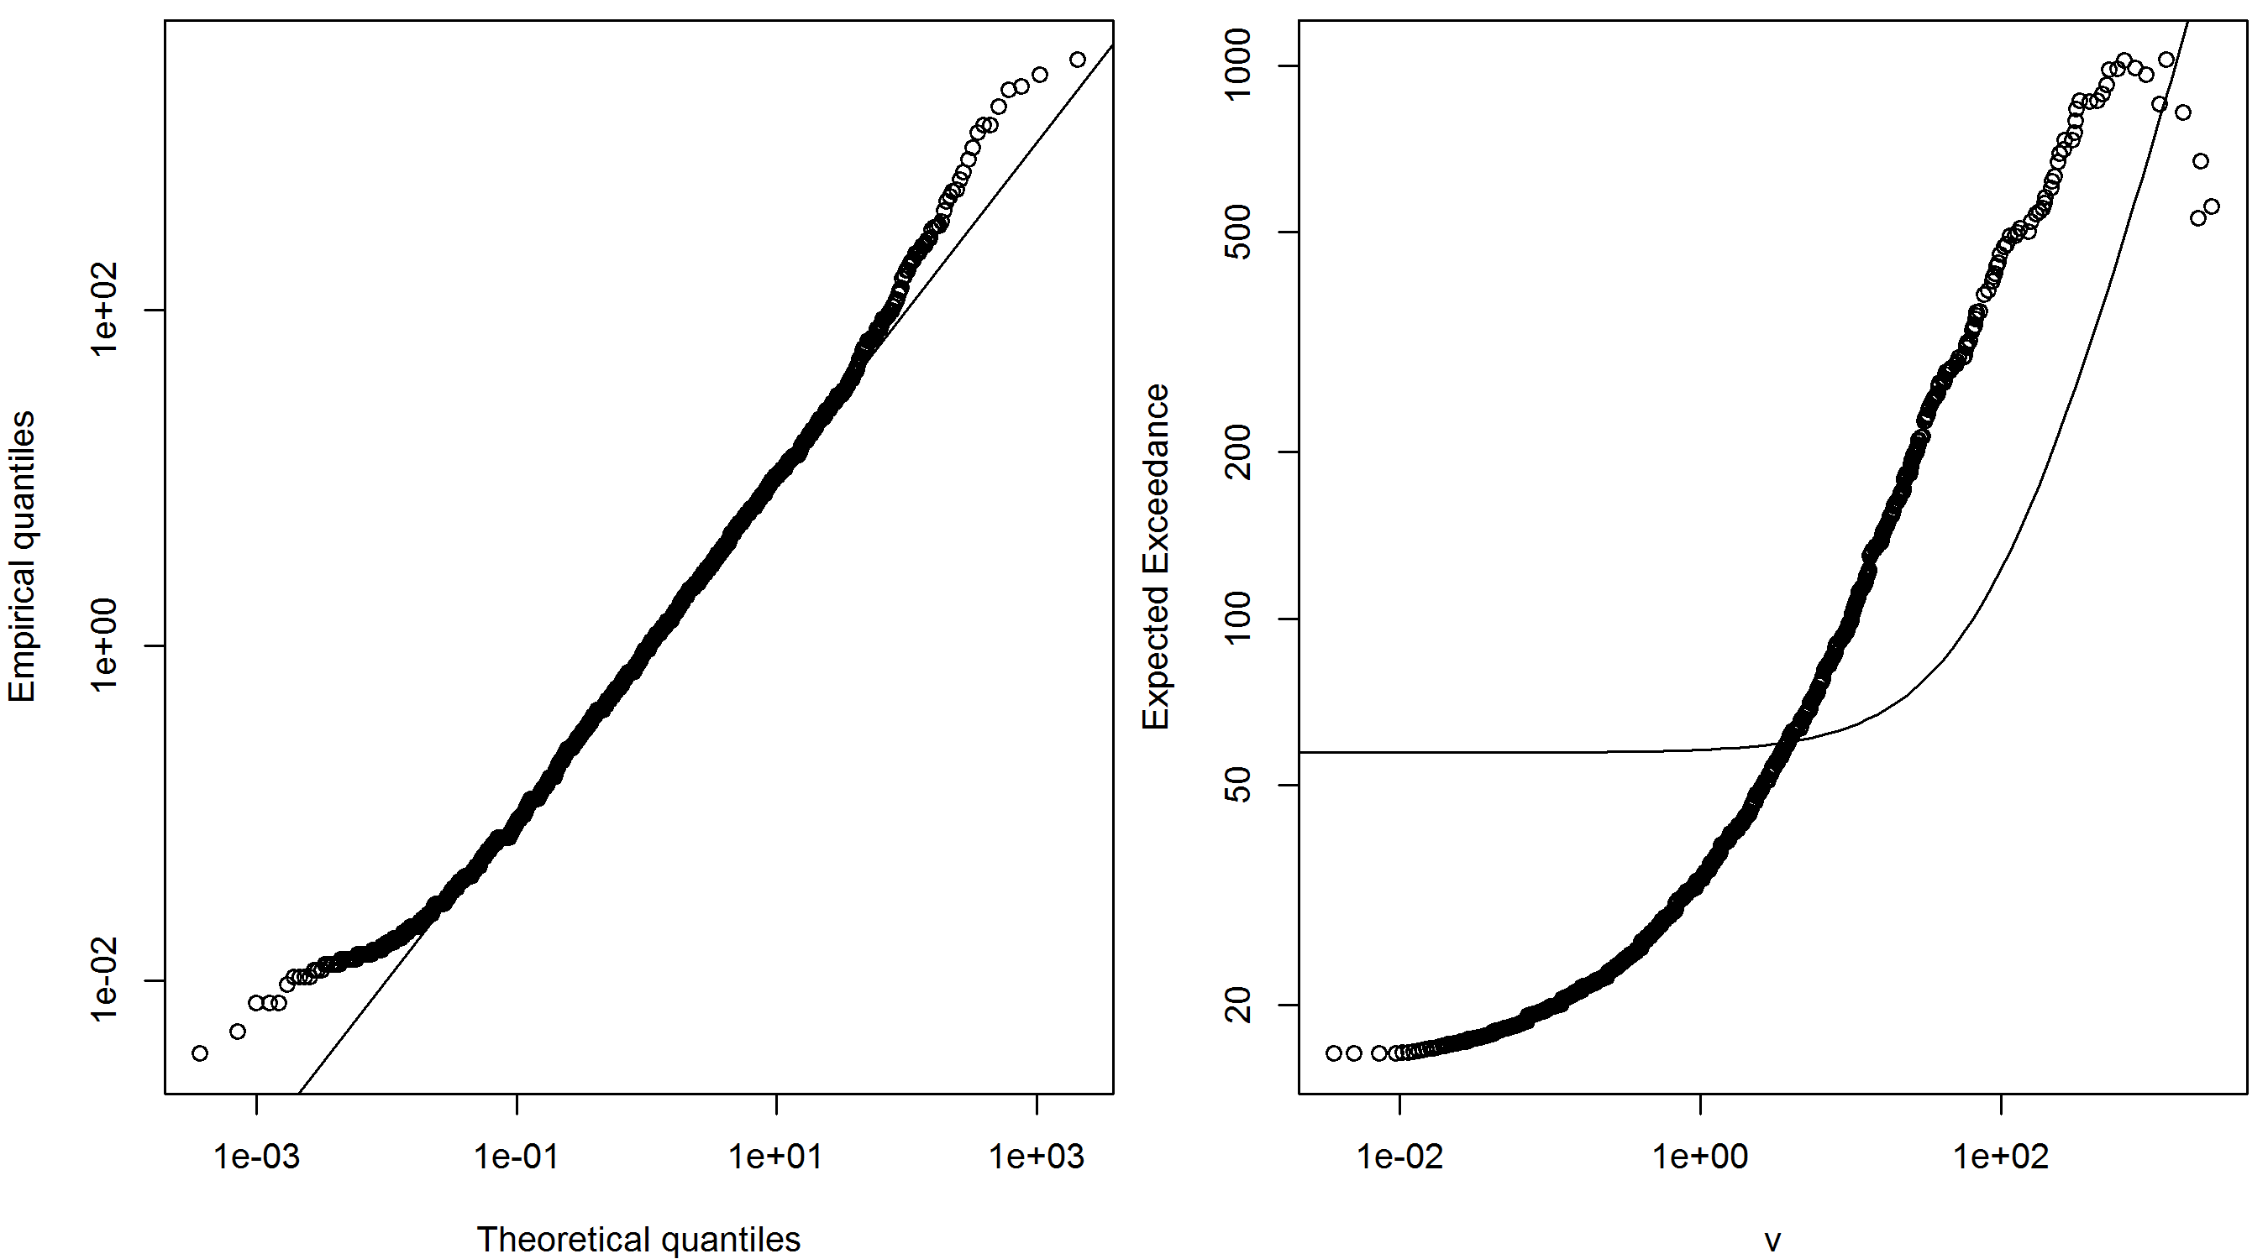
Characteristics of Cyber Risk
QQ Plot (vs. Lognormal)
Expected Exceedance
Notes:
- Major problem: not explicit treatment of cyber risk in any framework ->unlock how it might be applicable
Need to be modelled differently:
- Operational Cyber Risk: Insurers digitalized their operations and are therefore prone to cyber risk
- Underwriting Cyber Risk: Stand alone (dedicated) cyber risk policies or it is included in liability & property insurance. Sometimes not clear whether cyber risk is included (see Sony vs. Zürich, 2011).
-Importantly: Probably a correlation between op and underwriting cyber risk
- RBC: national association of insurance commissioners

Slide 6
Characteristics of Cyber Risk
 | LogLik | AIC | BIC | KS | AD
Normal | -11’619.77 | 23’243.55 | 23’254.24 | 0.46 | -
Lognormal | -4’498.01 | 9’000.03 | 9’010.72 | 0.08 | 17.26
Generalized Pareto | -4’461.65 | 8’929.30 | 8’945.35 | 0.07 | 7.24
Peak over threshold (POT) | -4’456.43 | 8’922.85 | 8’949.59 | 0.06 | 11.05
Note: LogLik stands for the logarithmic likelihood of the maximum likelihood (ML) estimation, AIC for the Akaike information criterion, BIC for Bayesian information criterion, KS for the Kolmogorow-Smirnow test, and AD for the Anderson-Darling test. The POT approach slices a lognormal body and a Pareto distribution from the 80% quantile upwards.
Goodness-of-Fit
Notes:
Böhme et al:emphasise that better data would be required in order to estimate suitable copulas and parameters empirically.
pandemics (Bolot and Lelarge, 2009). Highly interconnected (dense) and low clustering networks provide an optimal environment for the spreading of malicious code. On the other hand, a local destruction of physical components, such as the breakdown of a submarine cable, will have more severe effects if the Internet’s topology has low density and high clustering. Thus, the same network properties can potentially increase the vulnerability to one threat and simultaneously enhance resilience to another one. As it is usually assumed that the Internet is a rather decentralised and dense network (e.g. Ahamad, 2012), pandemic-like attacks pose a bigger threat than to the local destruction of physical components

Slide 7
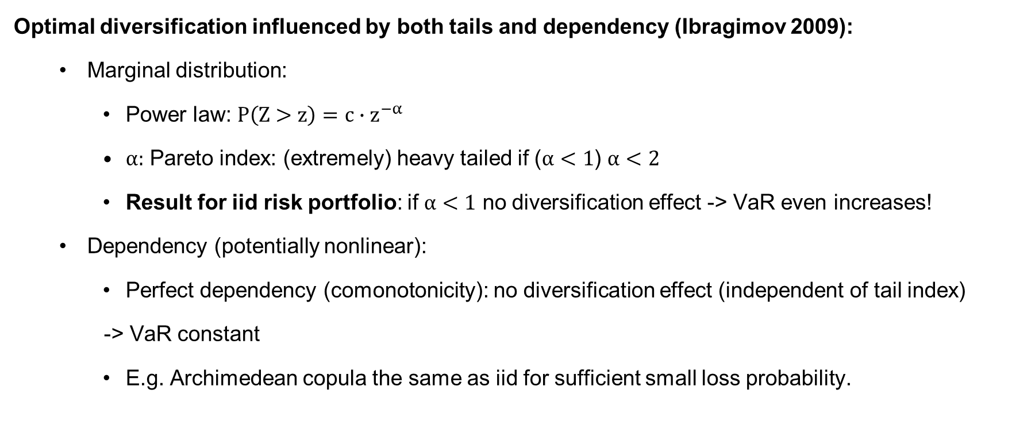
Cyber Risk and Diversification
Optimal diversification influenced by both tails and dependency (Ibragimov 2009):
  Marginal distribution:
    Power law: $P\left(Z>z\right)=c∙z^{−α}$
    $α:$ Pareto index: (extremely) heavy tailed if ($α<1$) $α<2$
    Result for iid risk portfolio: if $α<1$ no diversification effect -> VaR even increases!
  Dependency (potentially nonlinear):
    Perfect dependency (comonotonicity): no diversification effect (independent of tail index)
    -> VaR constant
    E.g. Archimedean copula the same as iid for sufficient small loss probability.
Notes:
-$α<2:I$nfinite second and higher moments
- Operational risks: α < 1 ⇒infinite means E|X| = ∞!, Firm sizes, sizes of largest mutual funds, city sizes: α ≈ 1, Economic losses from earthquakes: α ∈ [0.6, 1.5]
- Border a=1 is quite important (switch from finite to infinite mean)
If α > 1 diversification is optimal over non diversifikation (Ibragimov)
Sub- vs. superaditivity
Find that the estimated α<1
For $α<2$ : infinite variance and central limit theorem not applicable; instead convergence to a stable distribution with pareto index

Slide 8
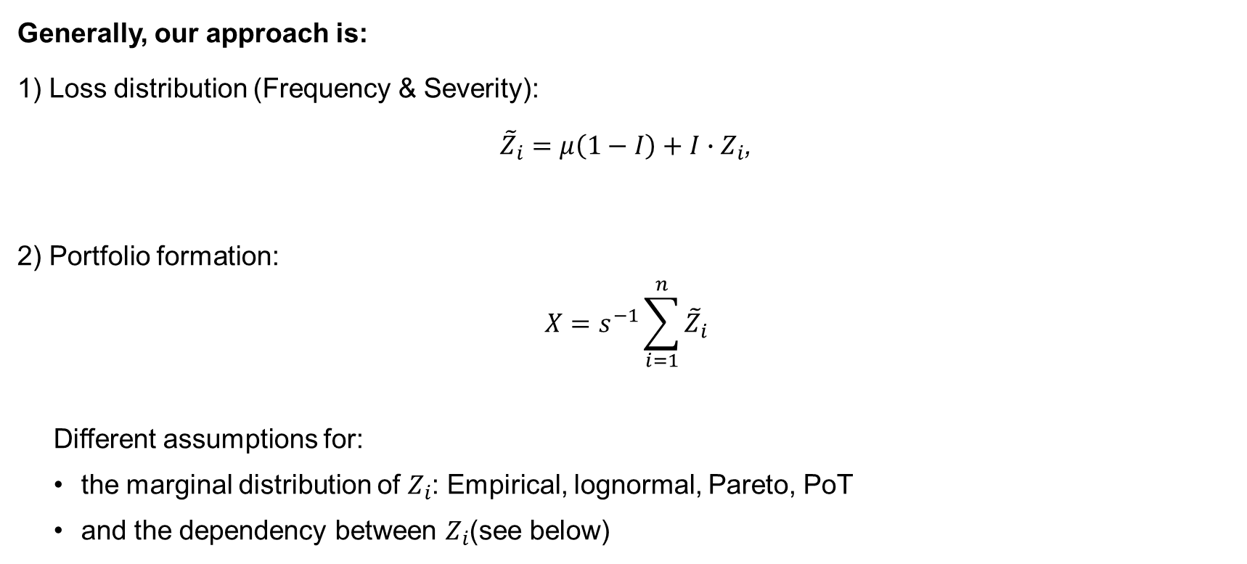
Methodology
Generally, our approach is:
1) Loss distribution (Frequency & Severity):
${\tilde{Z}}_{i}=μ\left(1−I\right)+I∙Z_{i}$,
2) Portfolio formation:
$$X=s^{−1}\sum_{i=1}^{n}{{\tilde{Z}}_{i}}$$
  Different assumptions for:
    the marginal distribution of $Z_{i}$: Empirical, lognormal, Pareto, PoT
    and the dependency between $Z_{i}$(see below)
Notes:
- $q:prob einen verlust nicht zu überschreiten$
SAS Data from Biener et al. (2015)
-$I$ is Bernoulli distributed meaning it is one with a probability $q$ and 0 with a probability $(1−q)$.

Slide 9
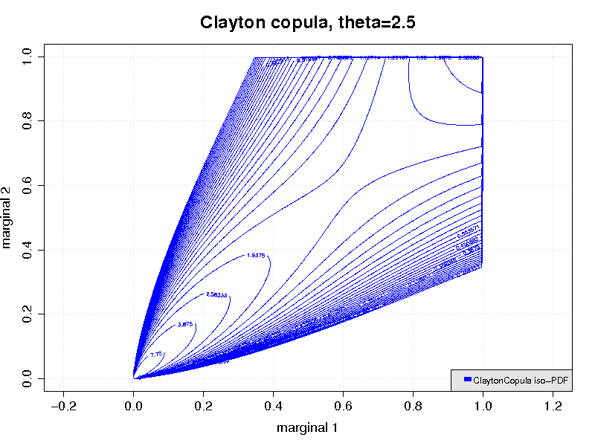
Methodology
Dependency
We assume strong negative tail dependency
Maybe due to significant spill-overs in times of extreme events
-> Clayton copula

Slide 10

Methodology
3) Limited liability or cover limits:
  $v\left(X\right)=\left\{\begin{aligned}X if X<k \\ k if X≥k\end{aligned}\right.$.
4) X is either simulated or its distribution is derived numerically (Panjer recursion)
5) Finally portfolio value is evaluated (see next slide)
Notes:
We need to assume how the model (of not clear) needs to be applied -> we can not ask the regulator for a ruling
- Frequency: for a portfolio of 50 (0.15*50), here Poisson model
- Severity: Caped at 50 Mio. USD, empirical distribution (defined on a lattice, h=0.1 Mio. USD)

Slide 11
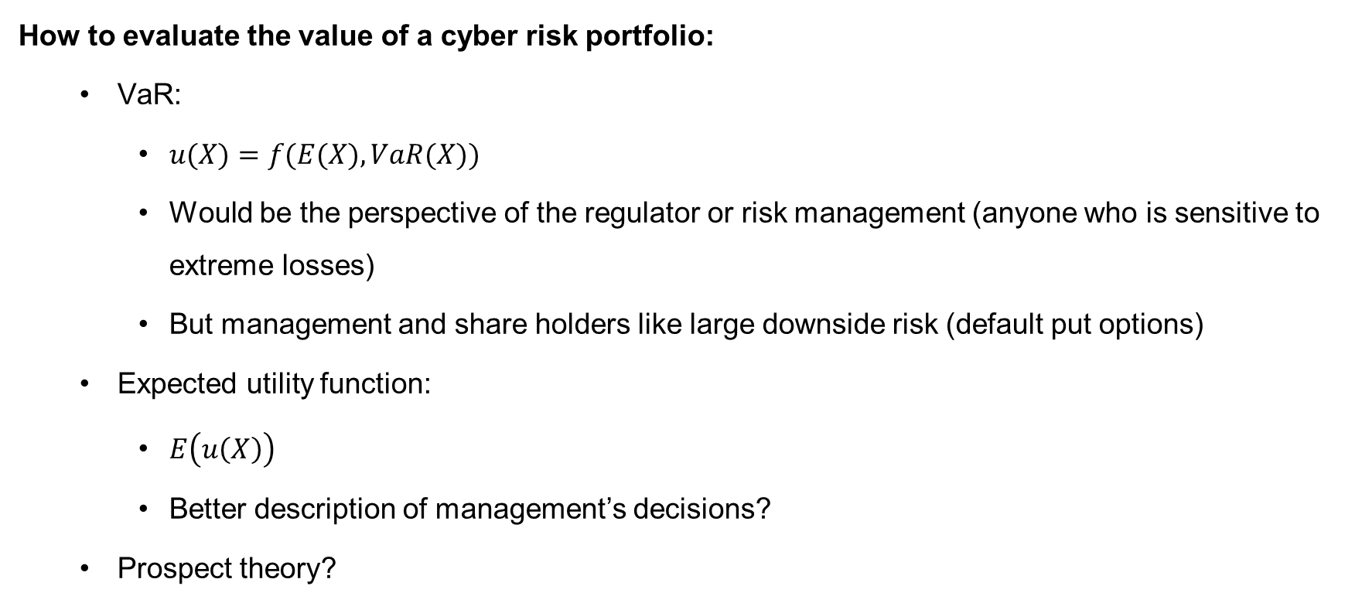
Methodology
How to evaluate the value of a cyber risk portfolio:
  VaR:
    $u(X)=f(E(X), VaR(X))$
    Would be the perspective of the regulator or risk management (anyone who is sensitive to extreme losses)
    But management and share holders like large downside risk (default put options)
  Expected utility function:
    $E\left(u\left(X\right)\right)$
    Better description of management’s decisions?
  Prospect theory?
Notes:
- Expected utility neglects loss aversion and probability weighting

Slide 12
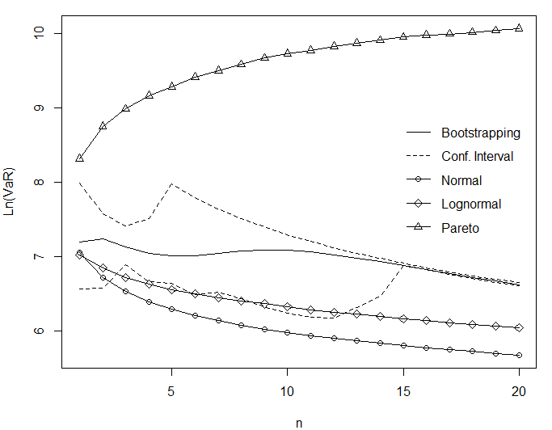
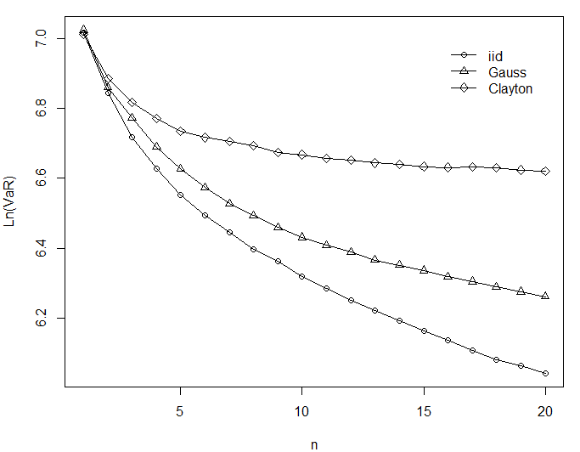
Cyber Risk and Diversification
Merits of Diversification
Independent
Dependent
Notes:
IID case:
Keeping portfolio size constant (Sum of n RVs devided by n)
Deterministic sum here
Simulated VaR as used by SII
Normal (α=2) & lognorm lead to decreasing VaR ->Merits of diversification
Pareto: Risk increases as portfolio size does
Classical: line A, in which each individual
insurance provider will choose maximal diversification into N risks, and in
which two insurance providers can always improve their situation by

Slide 13
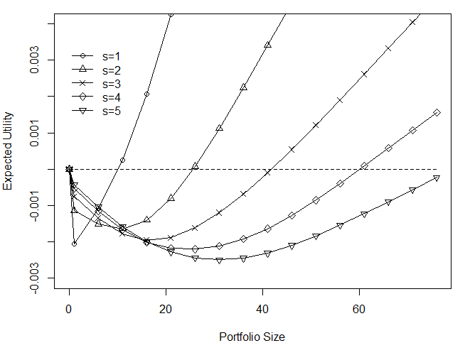
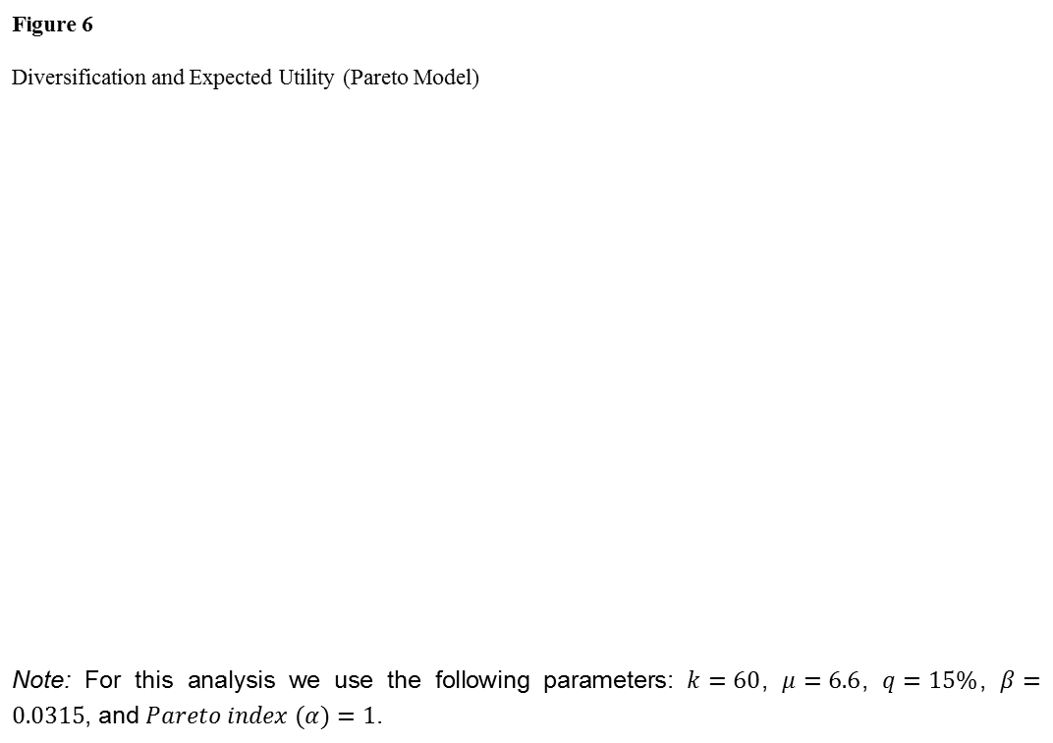
Cyber Risk and Diversification
Reinsurance / Insurance pool
Figure 6 Diversification and Expected Utility (Pareto Model)
Note: For this analysis we use the following parameters: $k=60$, $μ=6.6$, $q=15\%$, $β=0.0315$, and $Pareto index (α)=1$.

Slide 14
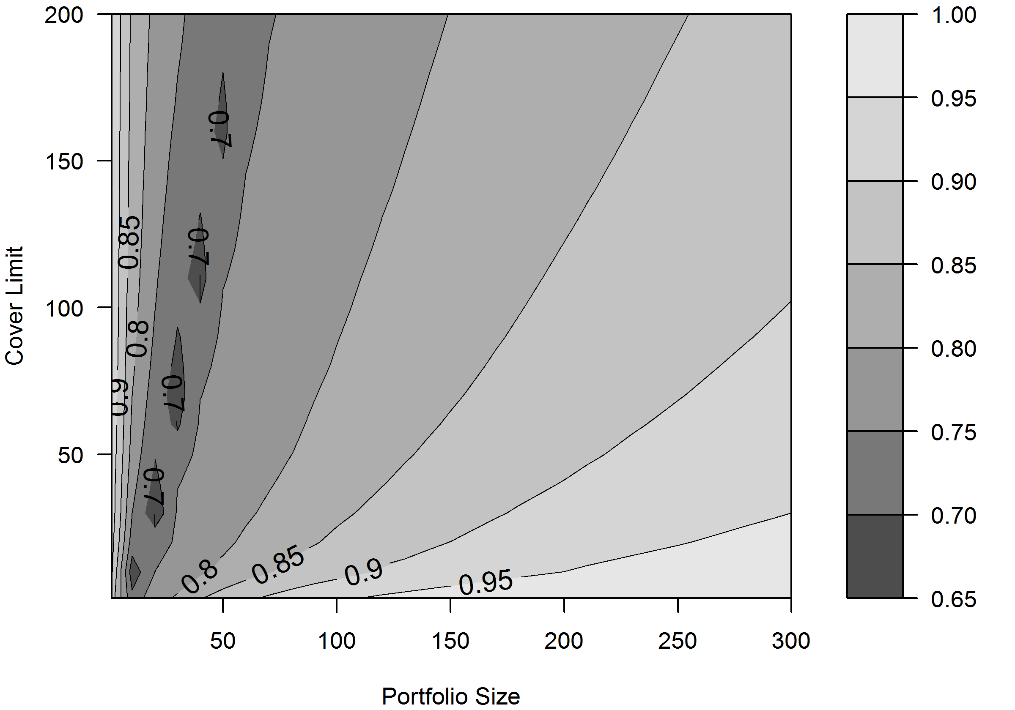
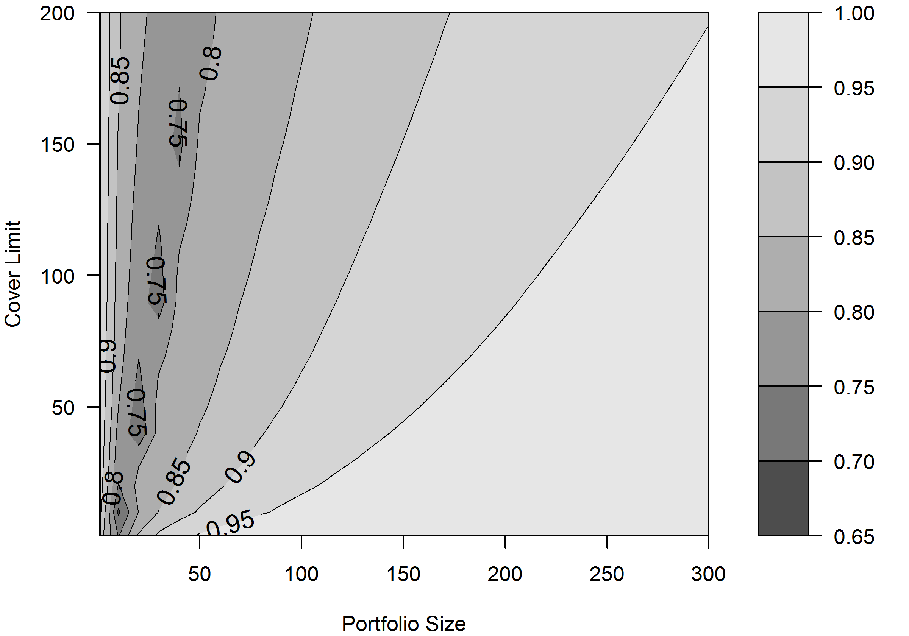
Excursion: Cyber Risk and Regulation
    Survival probability
    RBC
    SII
Notes:
-$α<2:I$nfinite second and higher moments
- Operational risks: α < 1 ⇒infinite means E|X| = ∞!, Firm sizes, sizes of largest mutual funds, city sizes: α ≈ 1, Economic losses from earthquakes: α ∈ [0.6, 1.5]
- Border a=1 is quite important (switch from finite to infinite mean)
If α > 1 diversification is optimal over non diversifikation (Ibragimov)
Sub- vs. superaditivity
- Find that the estimated α<1

Slide 15
Conclusion
Findings
Very heavy tails and strong (tail) dependencies cause diversification to fail:
  Genuine non-diversification trap
  Market stays underdeveloped unless subsidized
  However, a subsidized market might not be desirable from societies welfare perspective.
Very heavy tails combined with cover limits / limited liability might cause a U-shaped portfolio values:
  Market stays underdeveloped if coordination problem is not solved
  Utility eventually negative on an individual level but positive on a market level.
  Public support desirable
Notes:
-National Flood Insurance Program (NFIP)
-Terrorism Risk Insurance Act (TRIA)
Unable to accurately model or price terrorism exposures, reinsurers largely withdrew from the market for terrorism coverage. Without reinsurance, primary insurers were then compelled to exclude terrorism. Most state insurance regulators approved terrorism exclusions for use by primary insurers.
Congress responded by enacting TRIA in November 2002 to provide a government reinsurance backstop in case of large-scale terrorist attacks, requiring that business insurers offer terrorism coverage for the types of insurance included in the act

Slide 16
Conclusion
Implications
Generally, we can’t rely on classical mean variance analysis and results
Raison d’être of insurers questionable if they can not diversify.
Non-diversification leaves idiosyncratic risk price relevant and the premium charged by insurers even increases as more risks are pooled.
Multi equilibrium could emerge:
  Dynamically (times where reinsurance is available and when it is not)
  Segmentation of cyber market (separating different types of cyber risk)
Notes:
A major part of cyber threats distributes over the internet and therefore the correlation might be higher than for other underwriting risk. Moreover, extreme scenarios suggest that cyber risk could accumulate and become catastrophic
However, while insurers can geographically diversify cat risk, cyber risk propagated by the Internet does not know any boundary.
The limitation of this paper lays with the quality of available data and whether the data represents cyber risk in general well.
Diversification does not reduce VaR as expected: The regulator thus must account for that.
For example, since the risk does not decrease with diversification there should be no capital discount for diversification.
insurance). The traditional framework uses concave
optimization (e.g., via expected utility), with thin-tailed risks (e.g. normal
distributions), and without distortions (unlimited liability, no frictions and no
fixed costs). If any of these assumptions fails, diversification may not always be
preferred.5

Slide 17
Conclusion
Recommendations
Data quality and thus models should be improved:
  Data pools
  Reporting requirements
Regulators should consider heavy tails and tail dependencies in their capital models adequately (introducing dedicated risk categories).
Regulators must account for the fact that the VaR does not decrease as the number of risks in the underwriting portfolio is increased (no capital reduction for diversification).
Notes:
-E.g. SII is based on the lognormal; this seems not to be approbraiate if the risk is heavy tailed.
-The availability of better data in the future would open up new research opportunity.
-As there seems to be a game theoretical coordination problem

Slide 18
Conclusion
To overcome the diversification trap, the government could incentivize:
  the use and development of reinsurance (similar to e.g. TRIA)
  risk pools
  compulsory insurance supply (similar to e.g. TRIA)
  provide public insurance (similar to e.g. NFIP)
Disclaimer
SAS Data representative for underwriting cyber risk exposure?
Information asymmetries inherent in the cyber risk market not addressed

Slide 19
Conclusion
Possible Extensions
Model estimation:
  Including uncertainty would, due to ambiguity aversion, probably raise the cost for cyber insurance and could provide an additional explanation why the market is underdeveloped.
  How sensitive is our result to the parameter choice (Pareto parameter, cover limits, etc.)
  Extending analysis to a different data set (e.g. data breaches provided by PRC).
Equilibrium analysis (including demand side): Does a sufficiently high premium exist where the diversification trap would disappear but demand for insurance still exists?
Estimating the welfare loss of cyber market’s non existence
Notes:
Moreover, your analysis could be extended by modeling the premium endogenously as the market clearing price.
How reliable are the parameters estimated?

Slide 20
Questions and Discussion
Thanks a lot for your attention!

